Slide 1

Quantitative Imaging with a Mobile Phone Microscope
Arun Skandarajah, Clay D. Reber, Neil Switz, Daniel A. Fletcher

Slide 2
Table of Contents
Motivation
Analysis
Conclusion
2

Slide 3
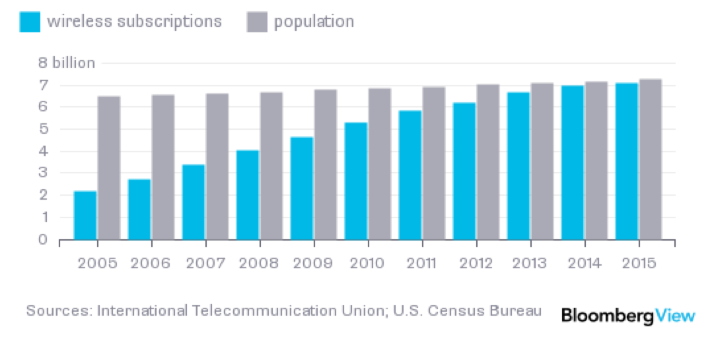
Motivation
As many active cellular phones as humans
Growing faster than population
3

Slide 4

Motivation
Service is also becoming more widely available in resource-deprived regions
4

Slide 5
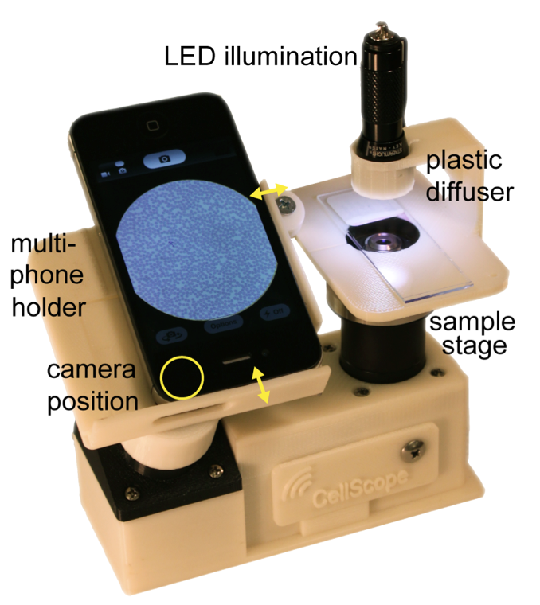
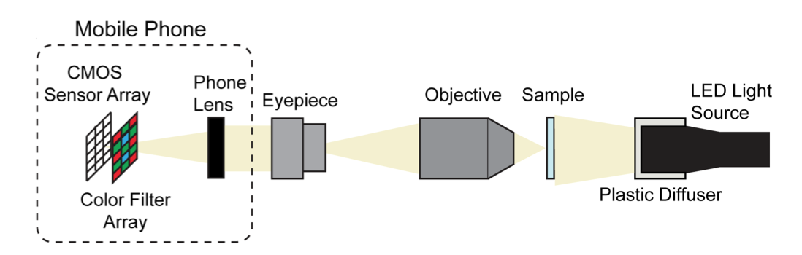
Motivation
But, can it really compare to a scientific camera?
5

Slide 6
Analysis
Phone vs. Rayleigh Resolution
Spatial Resolution vs. Phone
Phone Automation
Post Processing
6

Slide 7
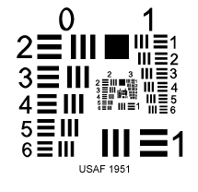
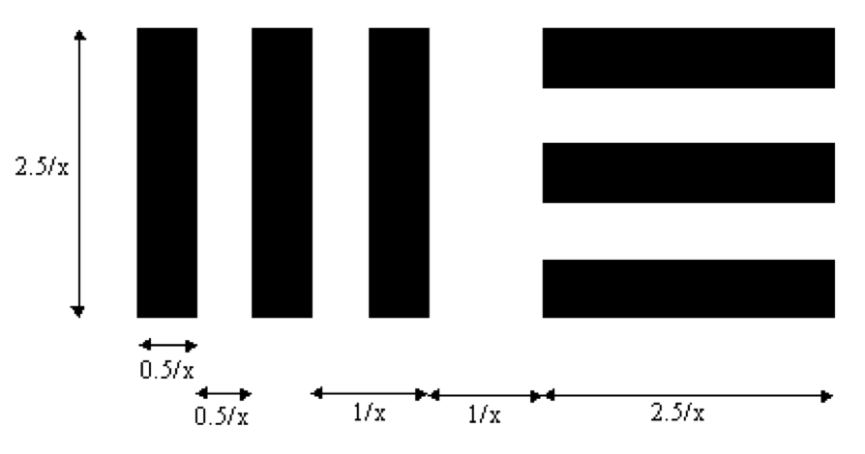
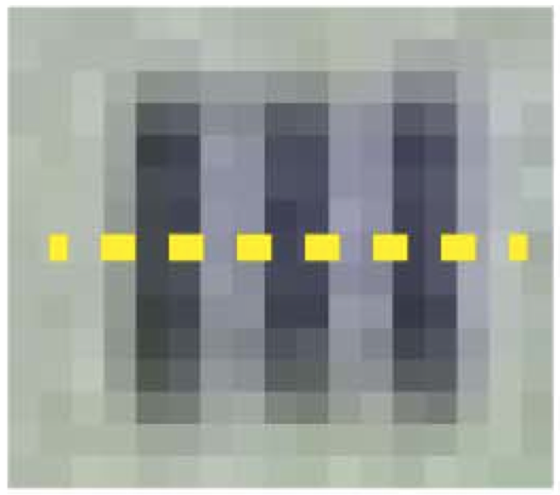
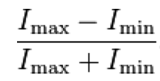
Analysis
Resolution Metric
Michelson Contrast =
7

Slide 8
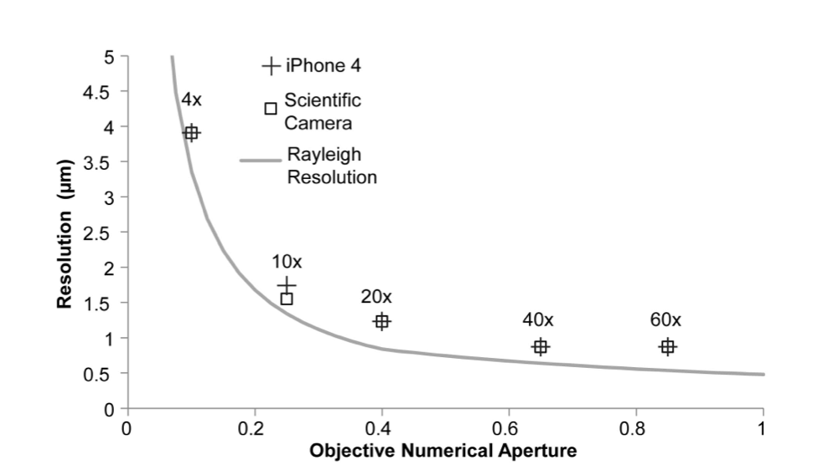
Phone vs. Rayleigh Resolution
4x, 0.10 NA
10x, 0.25 NA
20x, 0.40 NA
40x, 0.65 NA
60x, 0.85 NA
8

Slide 9
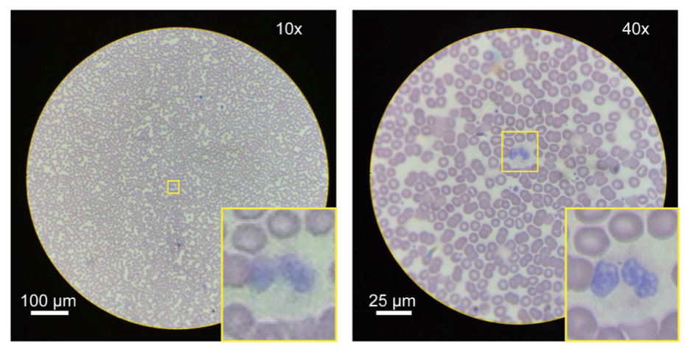
Phone vs. Rayleigh Resolution
9

Slide 10
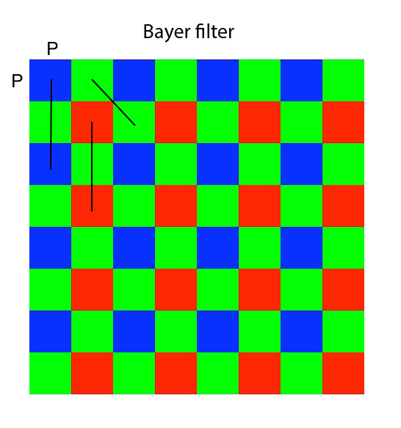
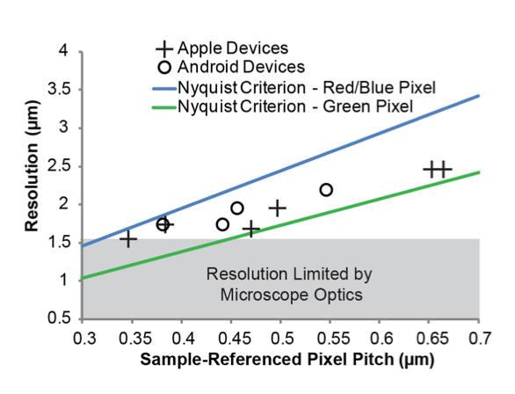
Spatial Resolution vs. Phone
10

Slide 11
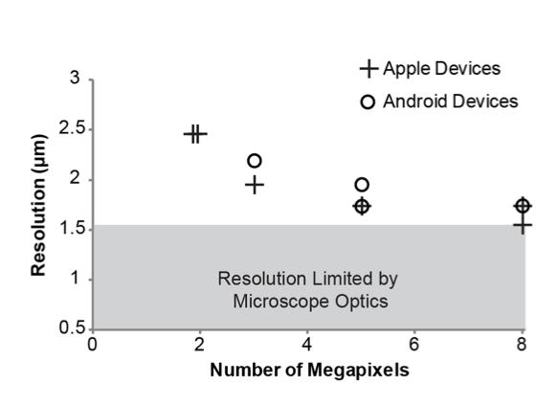
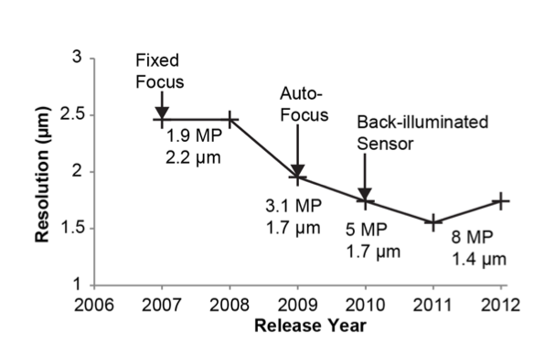
Spatial Resolution vs. Phone
11

Slide 12
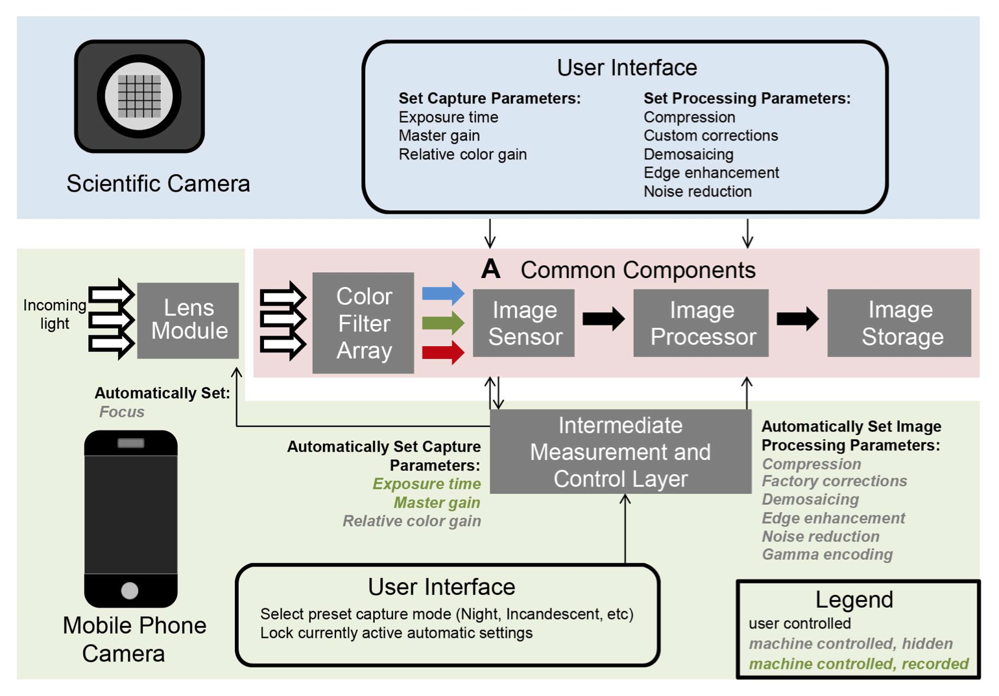
Phone Automation
12

Slide 13
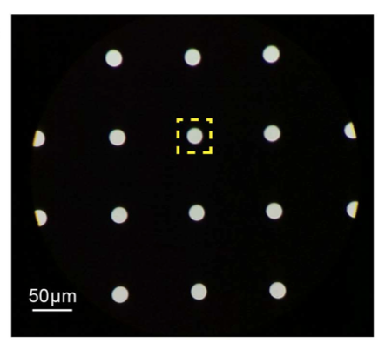
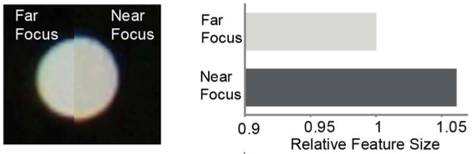
Phone Automation
Auto-Focus
13

Slide 14
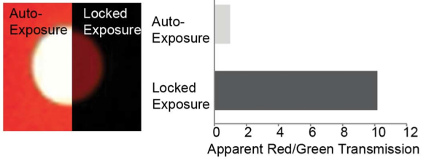
Phone Automation
Auto-Exposure
14

Slide 15
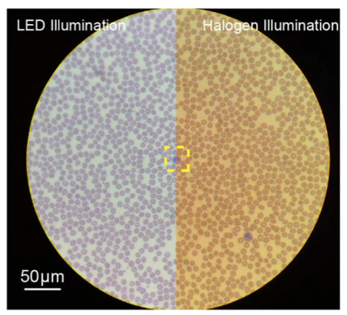
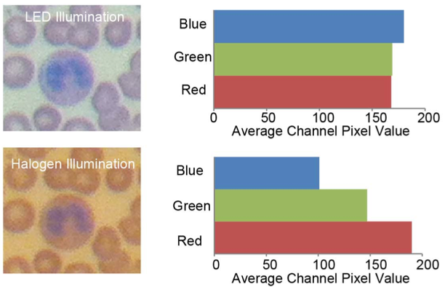
Phone Automation
Auto-White Balancing
15

Slide 16
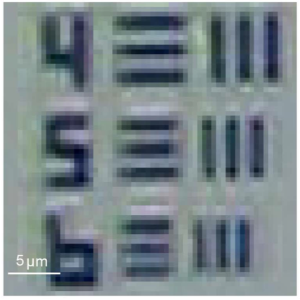
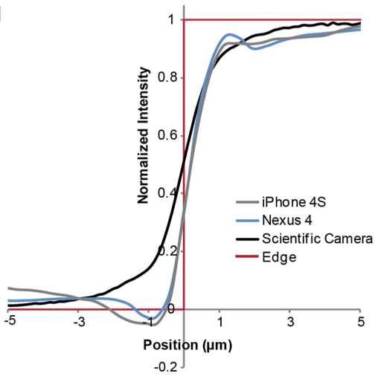
Post Processing
Edge Sharpening
16

Slide 17
Post Processing
DICOM
Standard for handling, storing, printing, and transmitting information in medical imaging
Image can maintain diagnostic quality when jpeg compression does no more than a 15-20x file size reduction – most phone comply
17

Slide 18
Conclusion
Due to scale of commercial manufacturing, cell phone-based imaging is an attractive low-cost, yet viable solution
In order the realize the full benefits, manufacturer cooperation must be utilized
18

Slide 19
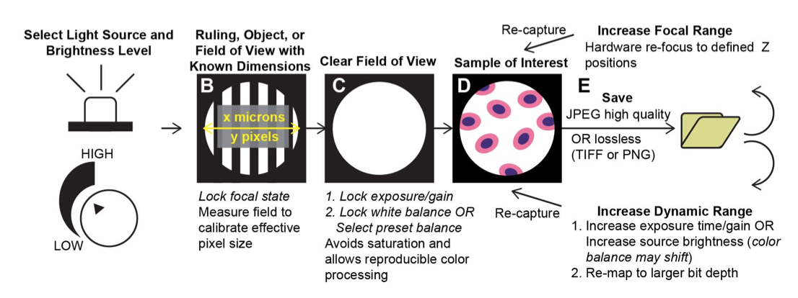
Conclusion
19

Slide 20
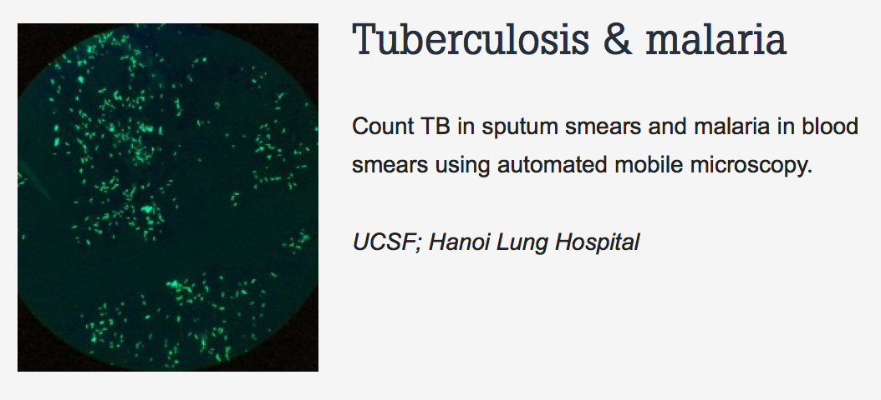
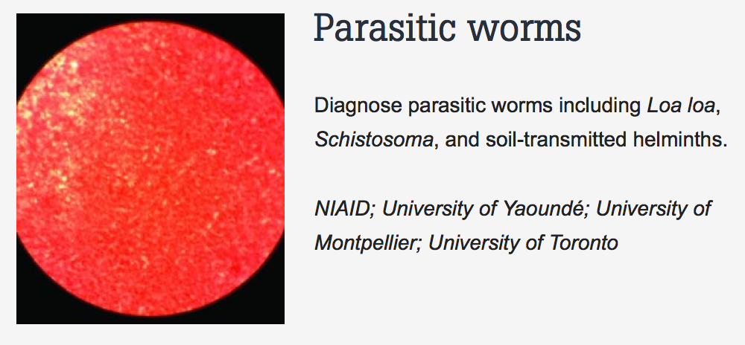
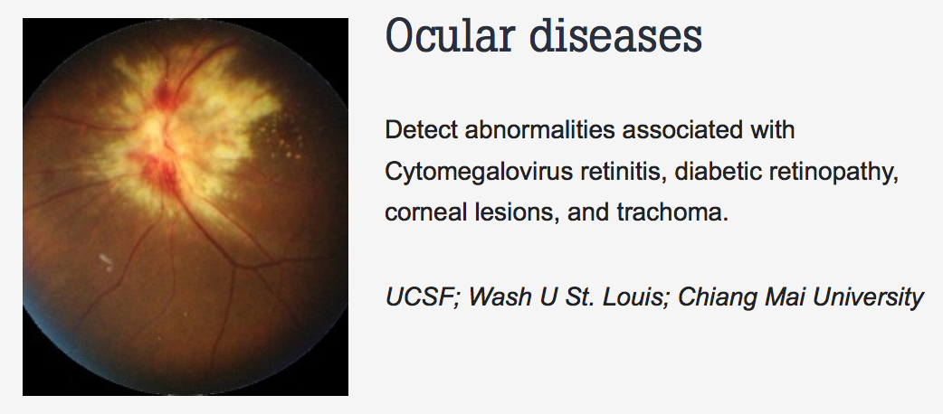
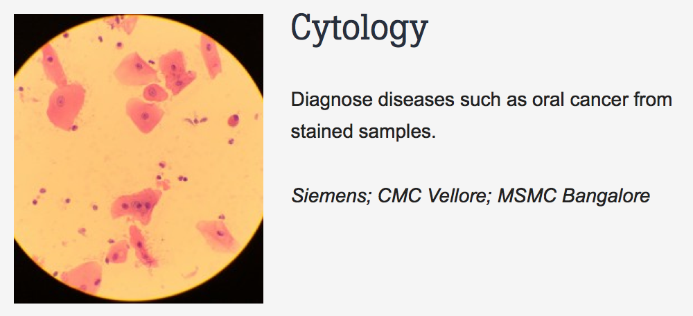
Conclusion
20

Slide 21
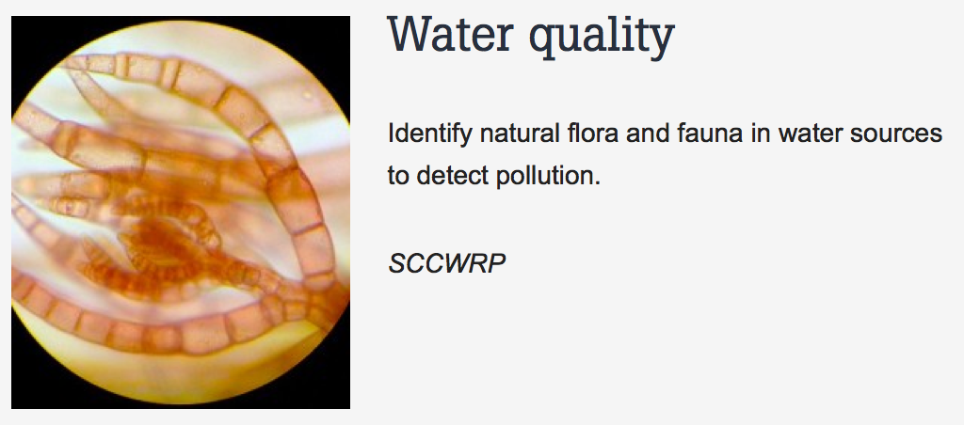
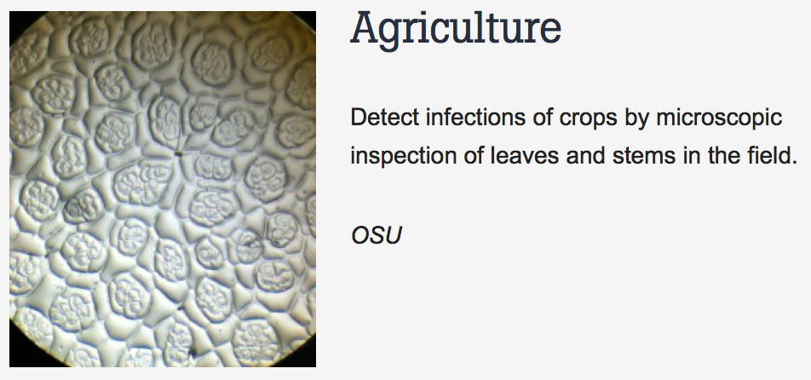
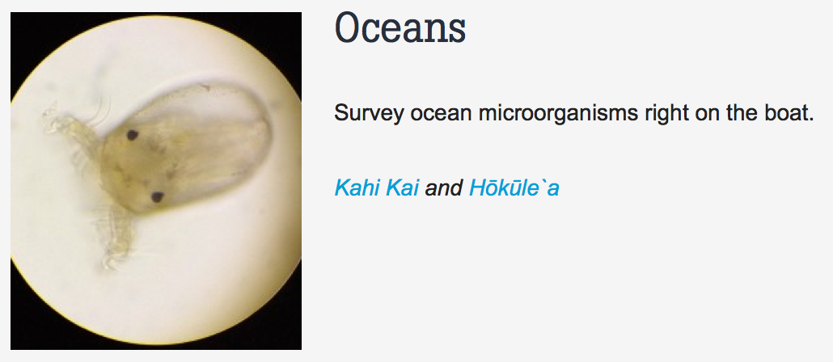
Conclusion
21

Slide 22
Questions?
22

Slide 23
References
Skandarajah A, Reber CD, Switz NA, et al. Quantitative imaging with a mobile phone microscope. Plos One 2014;9(5):e96906
23

